Slide 1
Gradient Checking

Slide 2
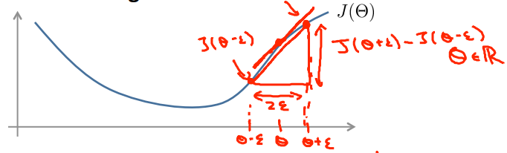
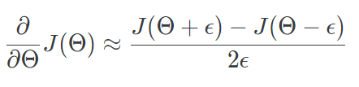
Gradient checking
Gradient checking will assure that our backpropagation works as intended.

Slide 3
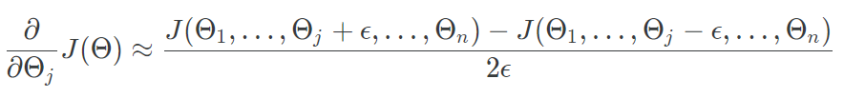
Gradient checking
With multiple theta matrices:
Usually uses the value epsilon = 10⁻⁴

Slide 4
Gradient Checking
Implementation Note:
Implement backpropagation.
Implement numerical gradient checking.
Make sure they give similar values.
Turn off gradient checking (The code to compute is very slow). Using backprop code for learning.

Slide 5
Random initialization

Slide 6
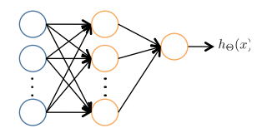

Random initialization
Set initialTheta = zeros(n,1) ?

Slide 7

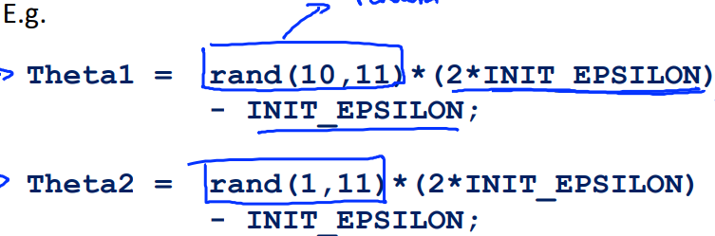
Random initialization

